Slide 1

Adaptive Resonance Theory Neural Networks

Slide 2
Introduction
ART stands for "Adaptive Resonance Theory", invented by Stephen Grossberg in 1976.
ART represents a family of neural networks.
The basic ART System is an unsupervised learning model.
The term "resonance" refers to resonant state of a neural network in which a category prototype vector matches close enough to the current input vector. ART matching leads to this resonant state, which permits learning. The network learns only in its resonant state.
ART neural network algorithm maintain the plasticity required to learn new patterns, while preventing the modification of pattern that have been learned previously.

Slide 3
Stability Plasticity Dilemma
Real world is faced a situation where data is continuously changing.
In this situation every learning system faces stability-plasticity dilemma.
Stability: System behaviour doesn’t change after irrelevant events.
Plasticity: System adapts its behaviour according to significant events.
Dilemma:
How to achieve stability without rigidity and plasticity without chaos?
Ongoing learning capability
Preservation of learned knowledge.

Slide 4
Stability Plasticity Dilemma
How does the system know to switch between its plastic and stable modes.
ART networks tackle the stability-plasticity dilemma.
The ART network and algorithm maintain the plasticity required to learn new patterns while preventing the modifications of patterns that have been learned previously.
Solves Stability – Plasticity Dilemma.
Forms new memories or incorporates new information based on a predefined vigilance parameter.

Slide 5
Key Innovation
The key innovation of ART is the use of “expectations”.
As each input is presented to the network, it is compared with the prototype vector that is most closely matches (the expectation).
If the match between the prototype and the input vector is NOT adequate, a new prototype is selected.
In this way, previous learned memories (prototypes) are not eroded by new learning.

Slide 6
ART Network
ART networks consist of an input layer and an output layer.
Bottom-up weights are used to determine output-layer candidates that may best match the current input.
Top-down weights represent the “prototype” for the cluster defined by each output neuron.
A close match between input and prototype is necessary for categorizing the input.
Finding this match can require multiple signal exchanges between the two layers in both directions until “resonance” is established or a new neuron is added.

Slide 7
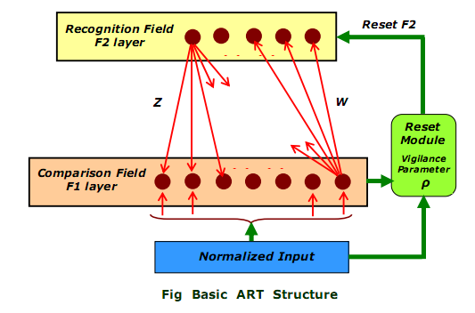
Basic ART network Architecture
The basic ART system is unsupervised learning model. It typically consists of: 1. a comparison field 2. a recognition field composed of neurons, 3. a vigilance parameter, and 4. a reset module

Slide 8
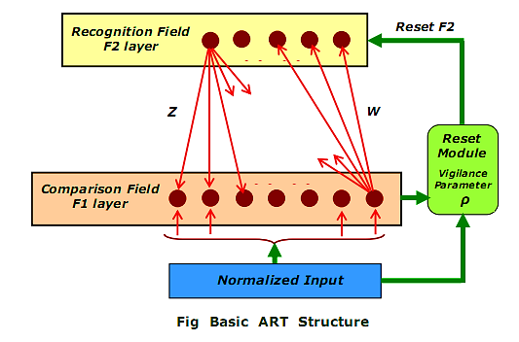
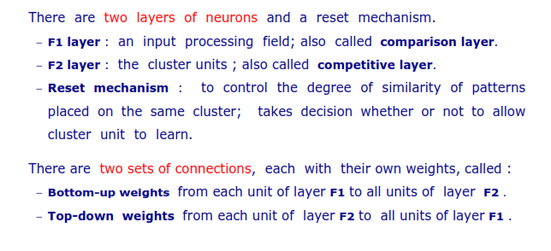
Basic ART network Architecture
1
2

Slide 9
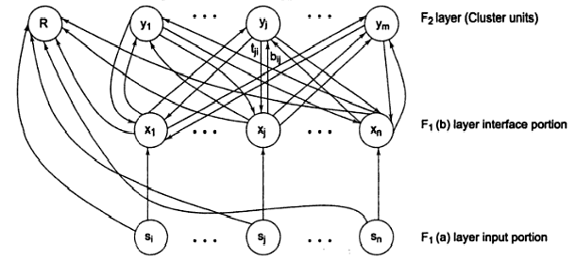
Basic Architecture
Tij (Bottom Up)
Bij (Top Down )

Slide 10
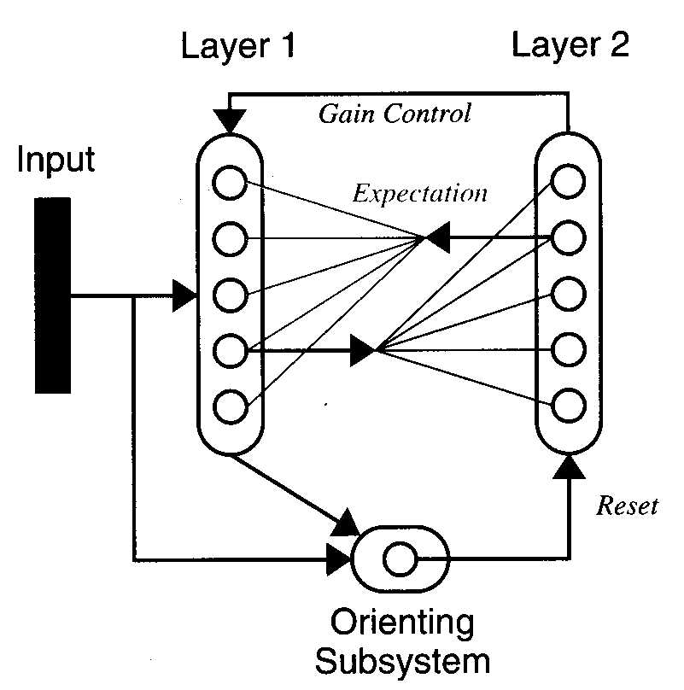
ART Subsystems
Layer 1
Comparison of input pattern and
expectation.
L1-L2 Connections
Perform clustering operation.
Each row of weights is a prototype pattern.
Layer 2
Competition (Contrast enhancement) winner-take-all learning strategy.
L2-L1 Connections
Perform pattern recall (Expectation).
Orienting Subsystem
Causes a reset when expectation does not match input pattern.
The degree of similarity required for patterns to be assigned to the same cluster unit is controlled by a user-defined gain control, known as the vigilance parameter

Slide 11
ART Algorithm
New Pattern
Recognition
Categorization
Comparison
known
unknown
Incoming pattern matched with stored cluster templates
If Incoming pattern close enough to stored template joins best matching cluster, weights adapted
If not, a new cluster is initialized with pattern as template
Adapt Winner Node
Initialize uncommitted node

Slide 12
ART Types
Unsupervised ARTs
Supervised ARTs
ART1
ARTMAP
ART2
Fuzzy ARTMAP
ART3
Fuzzy ART

Slide 13
ART Types
ART 1 is the simplest variety of ART networks, accepting only binary inputs.
ART2 support continuous inputs.
ART3 is refinement of both modal.
Fuzzy ART implements fuzzy logic into ART’s pattern recognition.
ARTMAP also known as Predictive ART, combines two slightly modified ART-1 or ART-2 units into a supervised learning structure .
Fuzzy ARTMAP is merely ARTMAP using fuzzy ART units, resulting in a corresponding increase in efficacy.

Slide 14
Application of ART
Facial recognition & Target recognition
Land cover classification
Medical diagnosis & Signature verification
Mobile robot control

Slide 15
Description of Algorithm
w
Binary input vector is applied to F1(a) then it is passed to F1(b) and it is send to F2 over weighted interconnections.
W
Binary input
F1(a)
F1(b)
F2
Each neuron at F2 will calculate the net input (i.e. dot product of input vector and its own weight).
F2
Dot product
input
W
The neuron with highest net input will win and learn new pattern and activation (d=1 ) for that neuron.

Slide 16
ART Algorithm
Parameters used in algorithm are :
n – Number of component in input vector.
m – Maximum number of clusters that can be formed.
b(ij) – Bottom up weight.
t (ji) – Top down weight.
p – Vigilance parameter ( set by user tester for testing the acceptance level for cluster to train if net input is less than p then it will not trained and vice-versa.)
s – Binary input vector.
x – Activation vector for F1(b).
||x|| - norm of vector x ( sum of all x(i)).

Slide 17
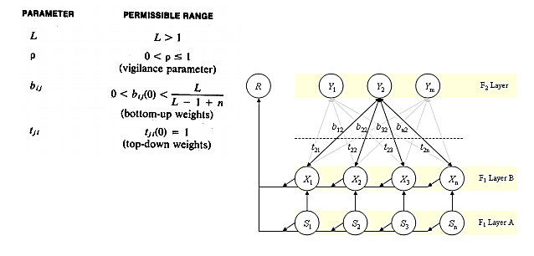
Initial Parameters used in algorithm are :
Bottom - up weights should be smaller than or equal to value
Top - down weights are initialized to 1

Slide 18
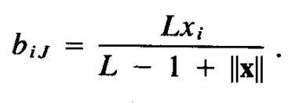
Steps to Perform ART Algorithm
Updates for both the bottom-up and top-down weights are controlled by
differential equations.
Step 1 : Initialize parameter
L>1 and 0<p<=1
Initialize weights
*Bottom-up weights should be smaller than or equal to value:
*Top-down weights are initialized to 1 Tji(0)=1
Step 2 : while stopping condition is false repeat step 3 to14
Step 3 : for each testing i/p repeat step 3 to 13
Step 4 : Set activation of all F2 units to zero
set F1(a) activation to input vector s.

Slide 19
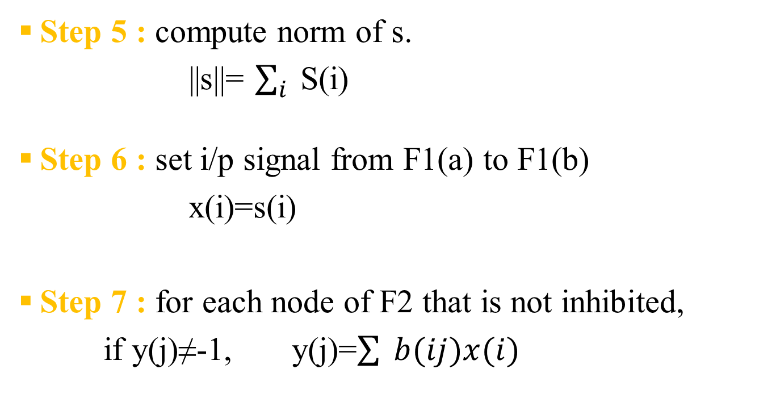
Steps to Perform ART Algorithm (cont.)
Step 5 : compute norm of s.
||s||= $\sum_{i}^{ }{ }$S(i)
Step 6 : set i/p signal from F1(a) to F1(b)
x(i)=s(i)
Step 7 : for each node of F2 that is not inhibited,
if y(j)≠-1, y(j)=$\sum{ }b(ij)x(i)$

Slide 20
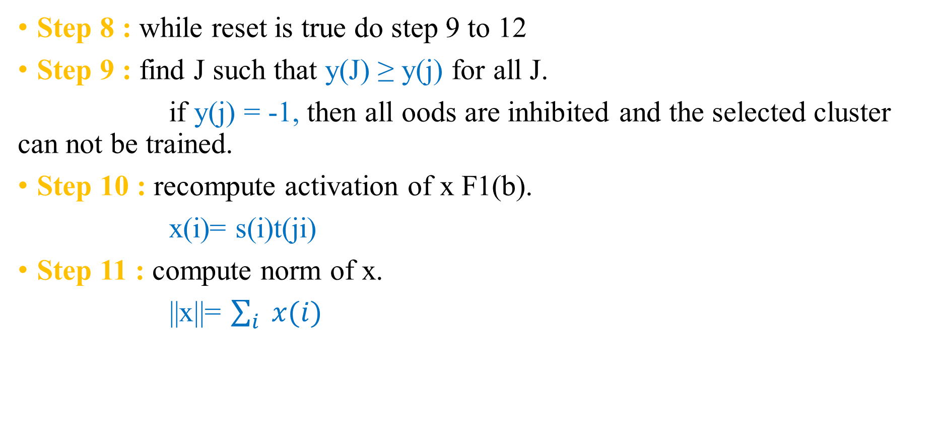
Steps to Perform ART Algorithm (cont.)
Step 8 : while reset is true do step 9 to 12
Step 9 : find J such that y(J) ≥ y(j) for all J.
if y(j) = -1, then all oods are inhibited and the selected cluster can not be trained.
Step 10 : recompute activation of x F1(b).
x(i)= s(i)t(ji)
Step 11 : compute norm of x.
||x||= $\sum_{i}{ x(i)}$

Slide 21
Steps to Perform ART Algorithm (cont.)
Step 12 : Test for reset
||x||/||s|| < p then,
y(j)=-1 cluster can not be trained , do step 8 again.
else, proceed to step 13.
Step 13 : Update weights of node j
b(ij) new = Lx(i)/(L-1+||x||)
t(ji) new = x(i)
Step 14 : Test for stopping condition.

Slide 22
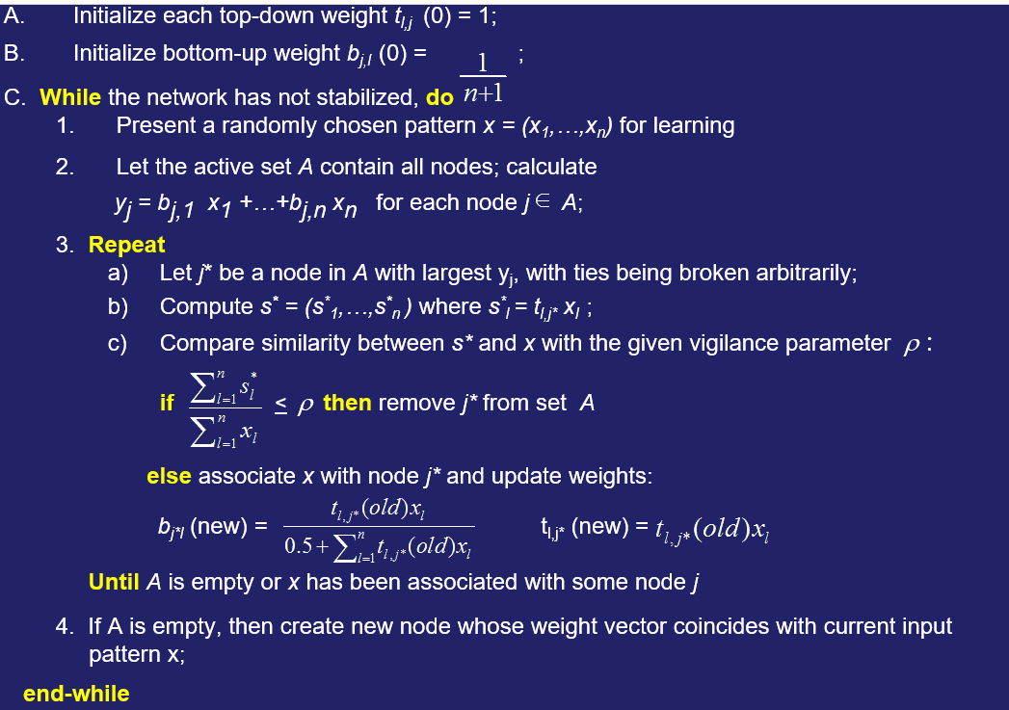
Steps to Perform ART Algorithm (cont.)

Slide 23
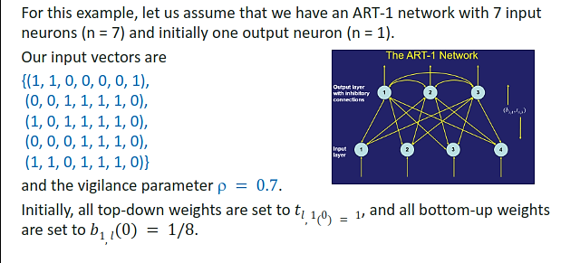

ART Example Computation

Slide 24
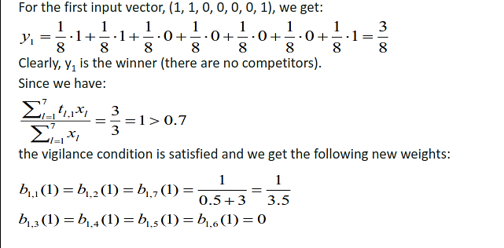
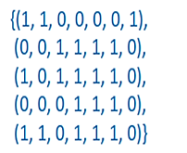

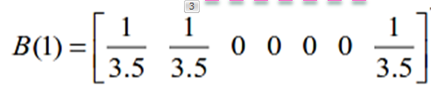


ART Example Computation
XI
b
$$∗$$

Slide 25
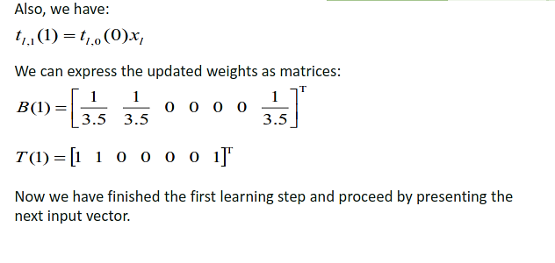


ART Example Computation
1
Bottom-up weights
Top-down weights

Slide 26
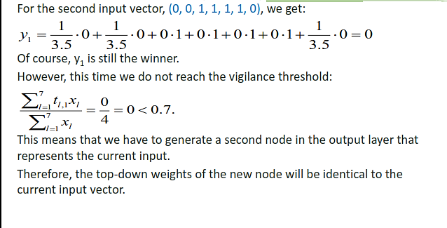
ART Example Computation

Slide 27
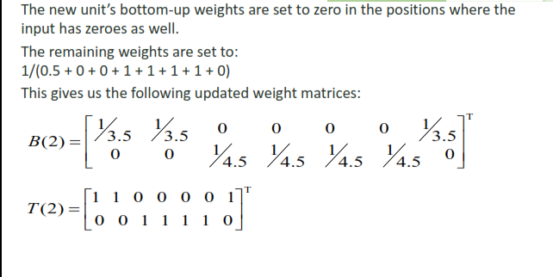

ART Example Computation

Slide 28
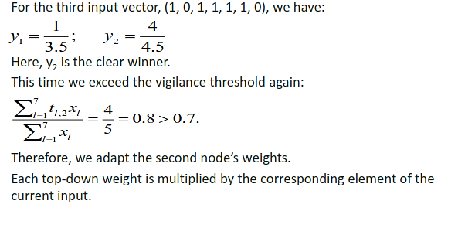
ART Example Computation

Slide 29
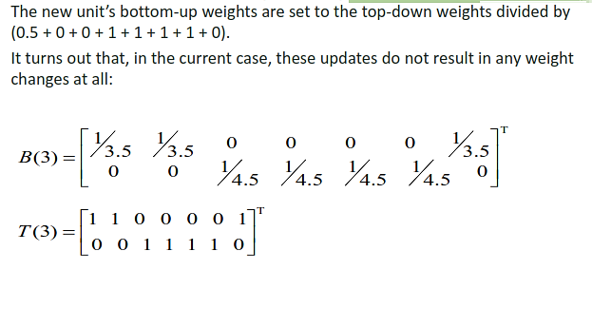
ART Example Computation

Slide 30
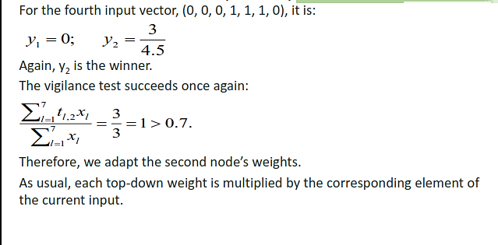
ART Example Computation

Slide 31
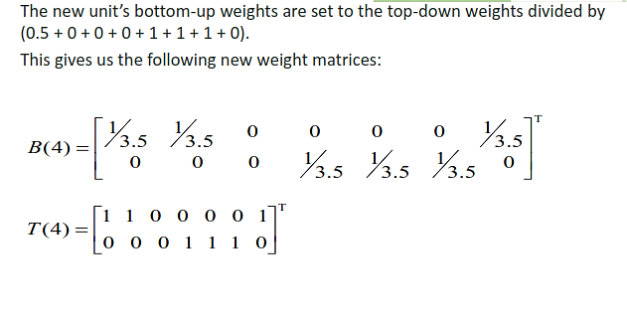
ART Example Computation

Slide 32
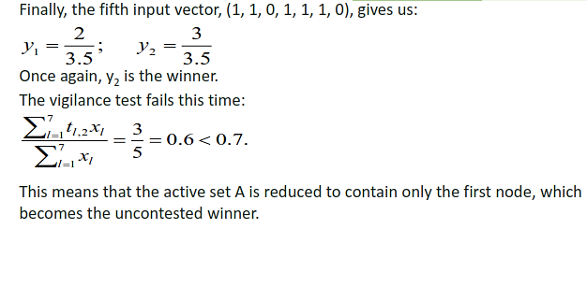
ART Example Computation

Slide 33
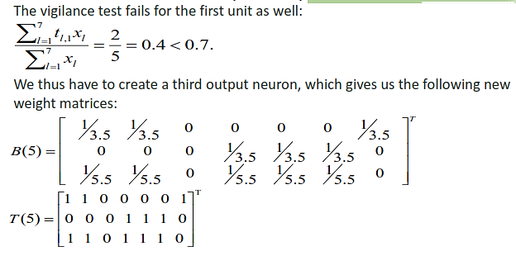
ART Example Computation

Slide 34
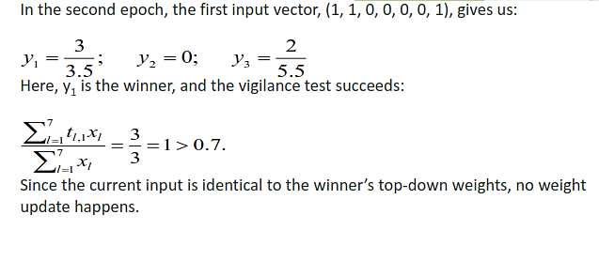
ART Example Computation

Slide 35
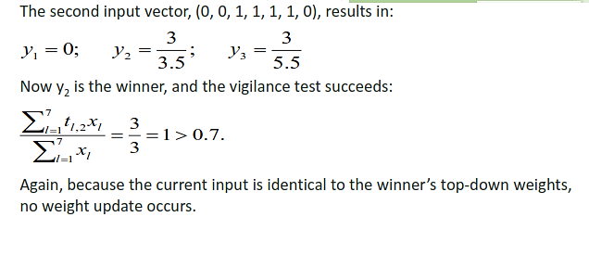
ART Example Computation

Slide 36
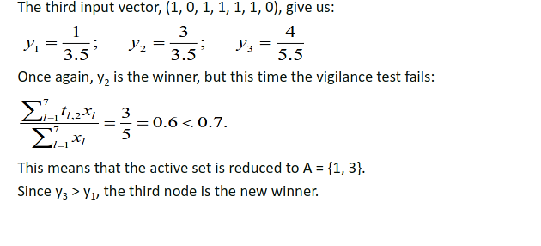
ART Example Computation

Slide 37
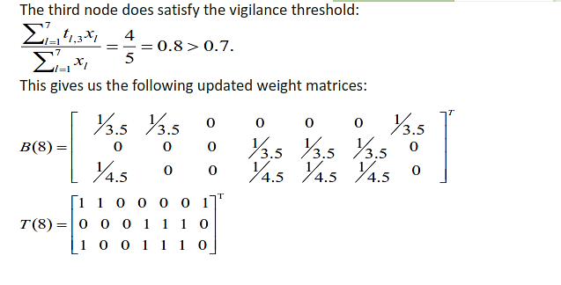
ART Example Computation

Slide 38
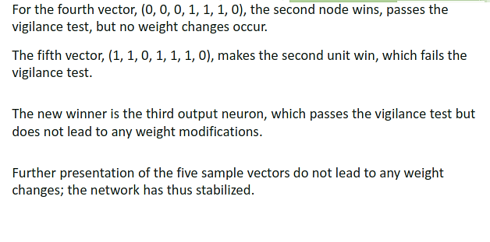
ART Example Computation

Slide 39
Conclusion
ART is Artificial Neural Network system that must be able to adapt to changing environment but constant change can make the system unstable ; because system may learn new information only by forgetting everything it has so far learned.

